Slide 1
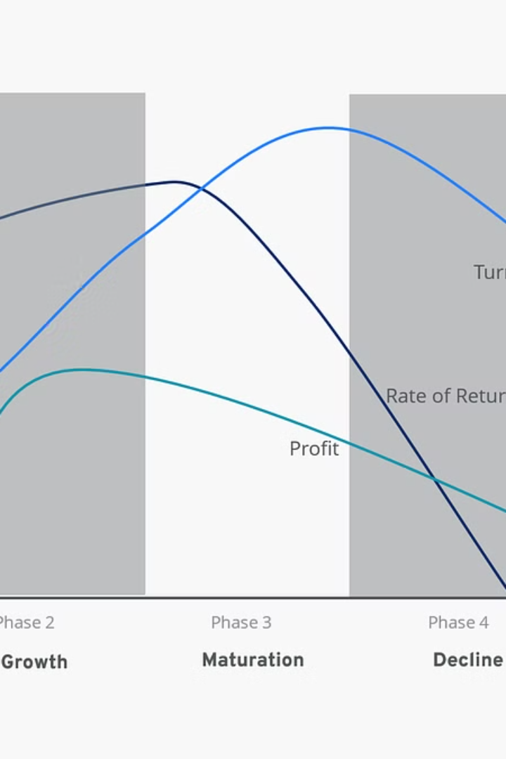

Understanding the Traditional Product Life Cycle
Explore the journey of a product from introduction to decline, and how it impacts process design and profitability.
by Aayush Kc

Slide 2
What is the Product Life Cycle?
1
Introduction
2
Growth
Costs are high, sales are low, heavy investment in promotion.
Rapid sales increase, profits peak, competition enters the market.
3
Maturity
4
Decline
Sales stabilize, competition intensifies, price wars to maintain market share.
Sales decline, profits diminish, decision to discontinue or revitalize.
Notes:
Introduction :The initial launch of a product is marked by high costs, low sales, and heavy promotion efforts to generate awareness and drive adoption. This stage is all about innovation and flexibility in the manufacturing processes to meet the evolving needs of the market.
2 Growth: As the product gains traction, sales increase, and profits peak. This stage is characterized by streamlining processes for efficiency to meet the rising demand. Competitors also begin to enter the market, intensifying
3)Maturity: competition. During the maturity stage, sales plateau, competition intensifies, and price wars may occur. Firms focus on cost reduction strategies to maintain profitability, optimizing their processes for maximum efficiency.
4 Decline The final stage of the product life cycle is the decline, where sales diminish, and profits become scarce. Firms must rationalize their processes, discontinuing unprofitable product lines, and make strategic decisions about the future of the product

Slide 3
Relationship with Process Design
Introduction
Growth
Maturity
Flexible processes to accommodate changes and innovations.
Streamlined processes to meet increasing demand efficiently.
Cost reduction and process optimization to maintain profitability.
Notes:
Introduction Stage During the introduction stage, the focus is on innovation and flexibility in manufacturing processes. Firms must be agile and adaptable to meet the evolving needs of the market and quickly respond to customer feedback.
Growth Stage As the product enters the growth stage, the emphasis shifts to streamlining processes for efficiency to meet the rising demand. Firms invest in automation, lean manufacturing, and supply chain optimization to optimize their operations.
Maturity & Decline Stages In the maturity and decline stages, firms prioritize cost reduction strategies to maintain profitability. This may involve rationalizing processes, discontinuing unprofitable product lines, and exploring outsourcing or offshoring opportunities.

Slide 4
Implications for Revenue Generation
Introduction
Growth
Limited revenue, heavy investment in R&D and marketing.
Significant revenue increase, improved profitability.
Maturity
Decline
Revenue stabilizes, focus on cost control and market share.
Revenue declines, strategic decisions to rejuvenate or explore new streams.
Notes:
Introduction Stage During the introduction stage, firms focus on investing in R&D and marketing to bring the new product to market. Revenue is limited, as the product is still in the early stages of adoption and the costs of launching the product are high.
Growth Stage As the product gains traction, revenue increases as sales surge, and profitability improves. Firms can leverage pricing strategies, product differentiation, and market segmentation to maximize their revenue during this stage.
Maturity Stage In the maturity stage, revenue remains stable, and firms shift their focus to cost control and market share retention. Diversifying revenue streams through aftermarket services, licensing, and royalties can help maintain profitability.
Decline Stage During the decline stage, revenue diminishes, and firms must make strategic decisions, such as divestment or product diversification, to counter the declining sales of the product

Slide 5




How Firms Make Money
Diverse Revenue Streams
Adaptive Strategies
Operational Efficiency
Innovation
Pricing adjustments, product differentiation, and targeted marketing.
Continuous improvement and new product development.
Beyond sales, revenue from licensing, royalties, and aftermarket services.
Cost control, lean manufacturing, and supply chain optimization.
Notes:
Diverse Revenue Streams Successful firms leverage a variety of revenue sources, such as sales, licensing, royalties, and aftermarket services, to maintain profitability throughout the product life cycle.
2 Adaptive Pricing and Positioning Firms adjust their pricing strategies, product differentiation, and market segmentation to respond to the changing dynamics of each stage of the product life cycle.
3 Operational Efficiency Cost control, lean manufacturing, and supply chain optimization are key strategies that firms employ to maintain profitability, especially during the mature and decline stages.
4 Continuous Innovation Successful firms prioritize innovation, whether through product improvements, new product development, or strategic partnerships, to stay ahead of the competition and sustain long-term growth

Slide 6

Case Study: Apple Inc.
1
Introduction
iPod revolutionized digital music players, leading to rapid growth.
2
Growth
iPhone launch propelled Apple into a new era of exponential growth.
3
Maturity
Apple diversified product line with offerings like iPad and MacBook.
Notes:
Introduction The iPod revolutionized the digital music player market, leading to rapid growth for Apple in the early 2000s.
2 Growth The launch of the iPhone propelled Apple into a new era of exponential growth, solidifying its position as a tech industry leader.
3 Maturity Recognizing the maturity of the smartphone market, Apple focused on product diversification, such as the iPad and MacBook, to sustain its revenue and market share.

Slide 7
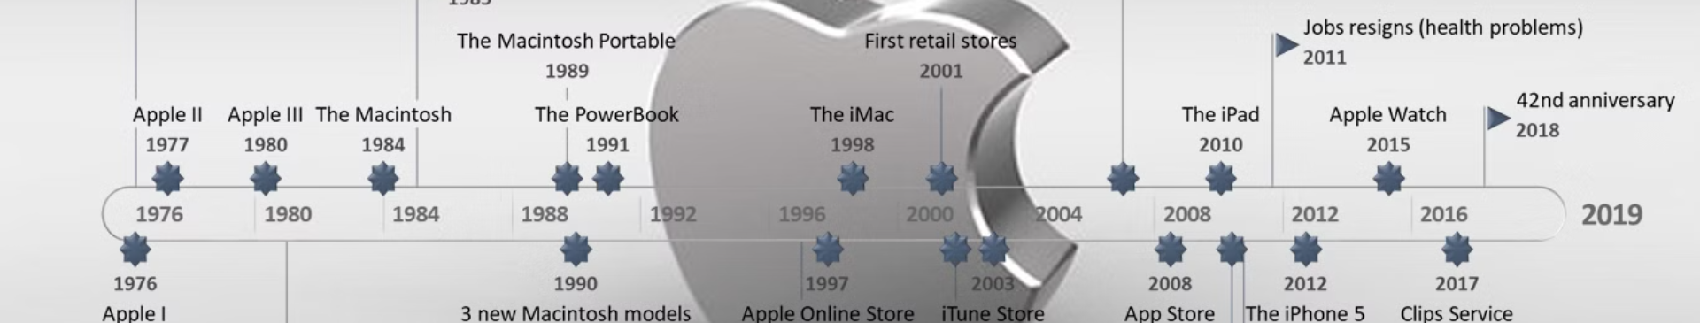



Adapting to Decline
Decline
Rejuvenation
Diversification
Innovation continued with products like Apple Watch and services like Apple Music.
Strategies to counter declining iPhone sales and maintain revenue.
Exploring new revenue streams beyond the core product line.
Notes:
Technological Advancements Rapid technological progress has shortened product life cycles, requiring firms to innovate and adapt at a faster pace to stay competitive. Globalization The interconnected global economy has increased competition and exposed firms to new markets, influencing the dynamics of the product life cycle. Sustainability Concerns Growing environmental awareness and social responsibility have prompted firms to consider the sustainability of their products and production processes throughout the life cycle. Evolving Customer Preferences Changing customer behaviors and expectations have forced firms to adapt their products and strategies to meet the dynamic needs of the market.

Slide 8

Key Takeaways
1
Product Life Cycle
2
Process Design
3
Revenue Generation
Guides companies through innovation, growth, maturity, and decline.
Adapts to changing demands, ensuring efficiency and competitiveness.
Requires diverse strategies tailored to each stage of the cycle.
Notes:
Understanding the traditional product life cycle and its stages is crucial for effective process design and revenue generation.
Firms must adapt their manufacturing processes to meet the changing demands of each life cycle stage, balancing innovation, efficiency, and cost control.
- Revenue generation strategies, such as diverse revenue streams, adaptive pricing, operational efficiency, and continuous innovation, are essential for sustaining profitability.

Slide 9


